Slide 1
Quiz Arrays
Simeon Angelov
Notes:
Hello everyone in the course on:
With me:

Slide 2
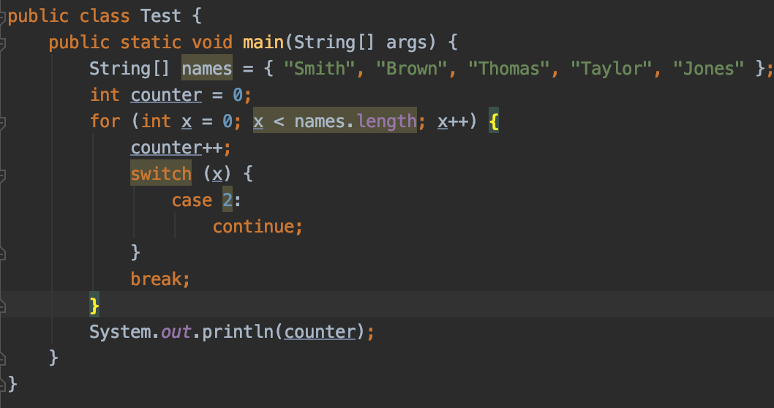
Q1. What will be the result of compilation and execution of next code?
a) 2
b) 5
c) Non of the other options
d) 3
e) 1
f) 4
g) 0
e) 1 because of the break;

Slide 3
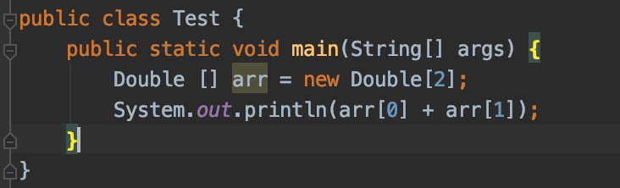
Q2. What will be the result of compiling and executing the code?
Compilation error
ClassCastException is thrown at runtime
0.0
NullPointerException is throw at runtime
D) Elements at position 0 and position 1 are null

Slide 4
Q3. What will be the result of compiling and executing of Test class?
[5, 10]
An exception is thrown at runtime
Compilation error
[50, 50]
public class Test {
public static void main(String[] args) {
short [] args = new short[]{50, 50};
args[0] = 5;
args[1] = 10;
System.out.println("[" + args[0] + ", " + args[1] + "]");
}
}
C) args already defined

Slide 5
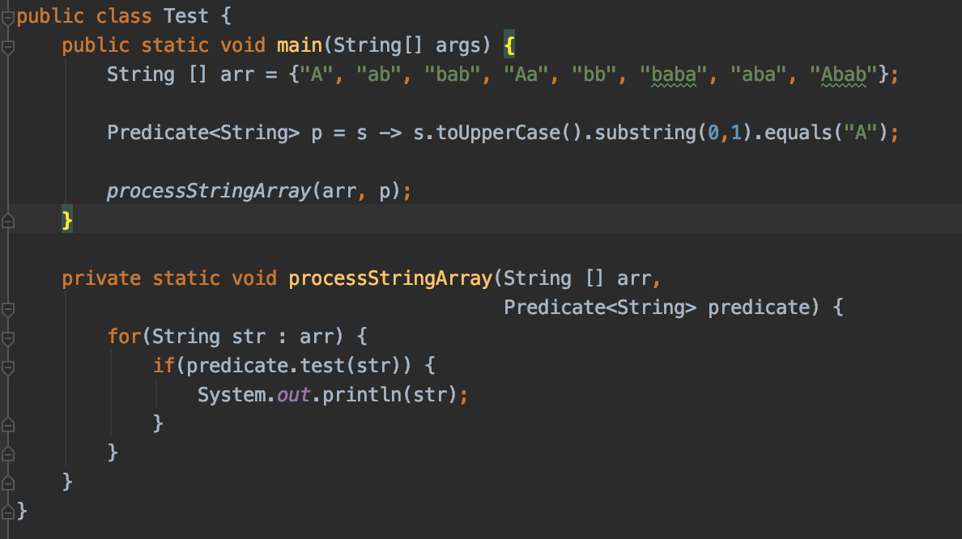
Q4. What will be the result of compiling and executing the Test class ?
ab
aba
b) Runtime exception
c) Compilation exception
d) A
ab
Aa
aba
Abab
e) A
Aa
Abab
D) Prints all string starting with ‘a’

Slide 6
Q5. Which of the following is not a valid declaration ?
int[][] a = new int[][5];
int[] a [] = new int[5][];
int[][] a = new int[5][5];
int[] a = new int[5];
a)

Slide 7
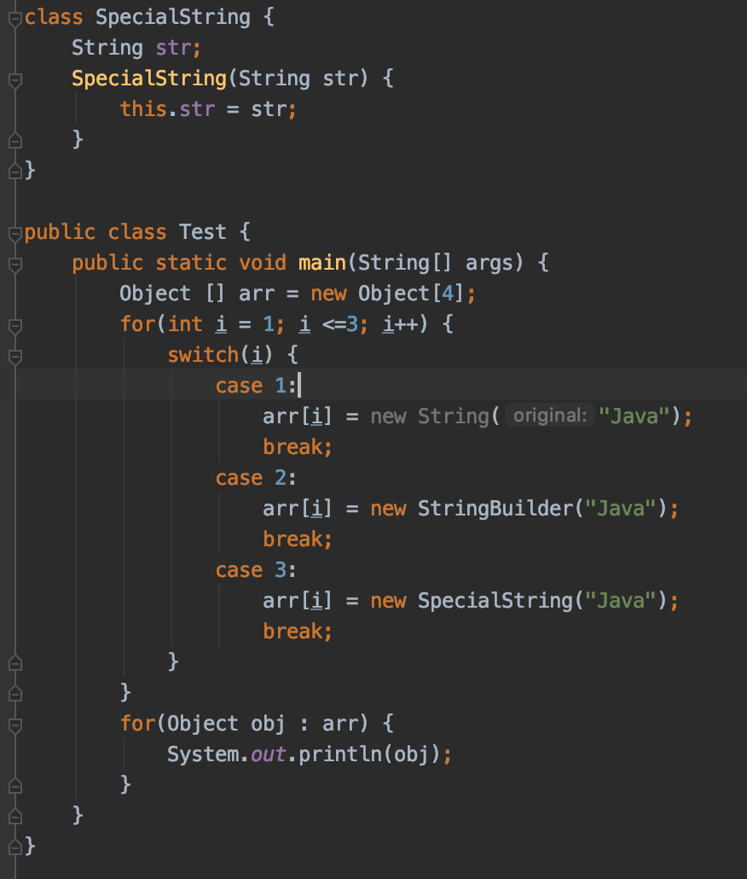
Q6 what will be the result of compiling and executing Test class ?
a) null
Java
Java
<some text with @ in it>
b) Java
Java
<some text with @ in it>
null
c) Java
Java
<some text with @ in it>
d) null
Java
<some text with @ in it>
<some text with @ in it>
e) Java Java null
f) null Java Java
Java
a)

Slide 8
Q7 What will be the result fo compiling and executing of Test class?
public class Test {
public static void main(String[] args) {
int [] arr = {2, 1, 0};
for(int i : arr) {
System.out.println(arr[i]);
}
}
}
a)
0
1
2
b)
2
1
0
c)ArrayIndexOutOfBoundsException
d) Compilation error
a) It prints the values of the elements from the last one to the first one

Slide 9
Q8. What will be the result of compiling and executing Test class?
​
a) Line 4 causes runtime exception
​
b) 0
​
c) 0.0
​
d) Line 3 causes compilation error
public class Test {
public static void main(String[] args) {
double [] arr = new int[2]; //Line 3
System.out.println(arr[0]); //Line 4
}
}
D)

Slide 10
Q9.
And below options:
1. int n = 0; n < arr.length; n += 1
2. int n = 0; n <= arr.length; n += 1
3. int n = 1; n < arr.length; n += 2
4. int n = 1; n <= arr.length; n += 2
How many above options can be used to replace /*INSERT*/,
such that on execution, code will print NET on to the console? A) All 4 b) Non of them c) Only 3 d) Only 2 f) Only 1
public class Test {
public static void main(String[] args) {
String [] arr = {"I", "N", "S", "E", "R", "T"};
for(/*INSERT*/) {
if (n % 2 == 0) {
continue;
}
System.out.print(arr[n]); //Line n1
}
}
}
A)

Slide 11
Q10.
And below statements:
1. short arr [] = new short[2];
2. byte [] arr = new byte[10];
3. short [] arr; arr = new short[3];
4. short [2] arr;
5. short [3] arr;
6. int [] arr = new int[]{100, 100};
7. int [] arr = new int[]{0, 0, 0, 0};
8. short [] arr = {};
9. short [] arr = new short[2]{5, 10};
How many above statements can be used to replace /*INSERT*/, such that on execution, code will print [5, 10] on to the console?
​
a)Only one option​
b)Only four options
c)More than four options
d)None of the given options
e) Only three options
f) Only two options
public class Test {
public static void main(String[] args) {
/*INSERT*/
arr[1] = 5;
arr[2] = 10;
System.out.println("[" + arr[1] + ", " + arr[2] + "]"); //Line n1
}
}

Slide 12
Thank You For Your Time

